Slide 1
Introduction to Google Colab
2021. 09.07 Jonghwa lee

Slide 2
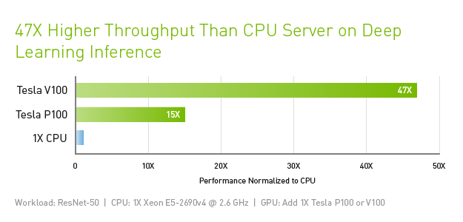
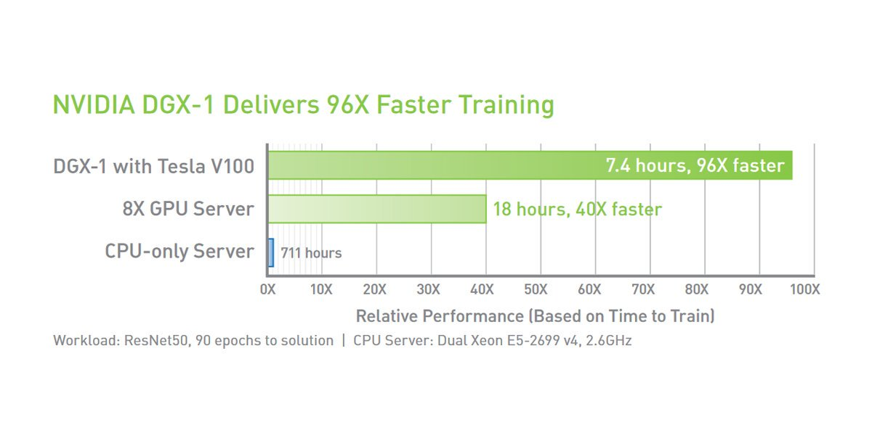
Deep learning requires a lot of hardware
To efficiently train a deep learning model, your hardware should be able to deal with a huge amount of data at high speed
CPUs are fast but their bandwidth is lower than GPUs
GPUs can perform a large number of matrix multiplications at a time
It allows you to build and train complex deep learning models on large dataset efficiently
However, high-performance GPUs are expensive

Slide 3
Google Colab to the rescue!
Google Colab (https://colab.research.google.com) is a free Jupyter notebook environment that requires no setup and runs entirely in the cloud
It currently offers the computing services of an NVIDIA Tesla K80 GPU for free
You can use the computing services for a maximum of 12 hours at a time
Basically, you are connected to a virtual machine that lives for a maximum of 12 hours at a time
All data including model parameters that aren’t saved to the Google Drive before this period will be lost

Slide 4
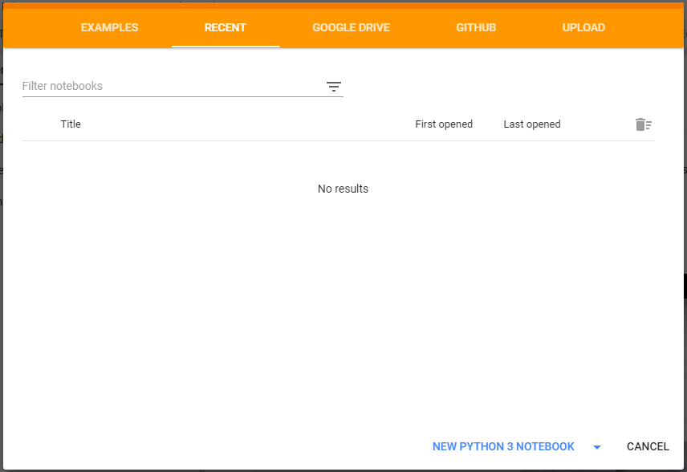
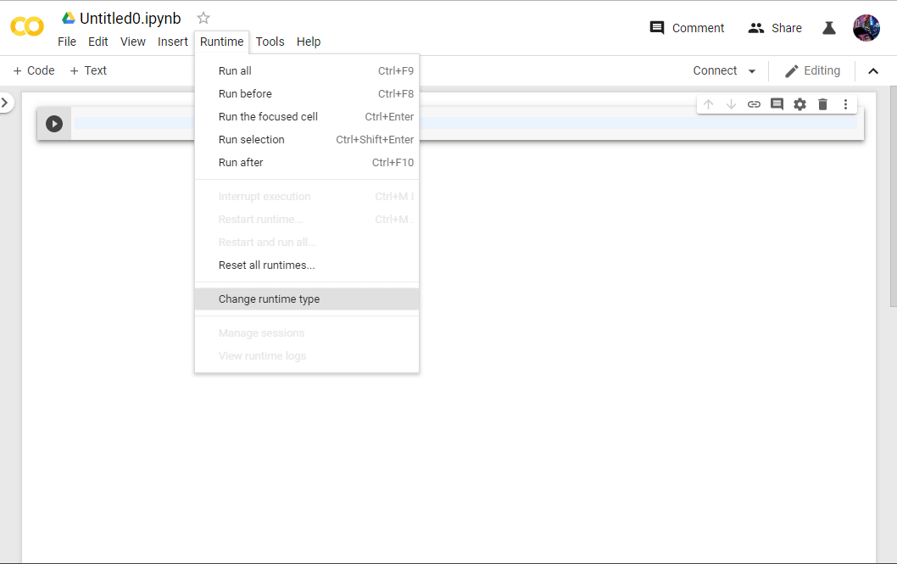
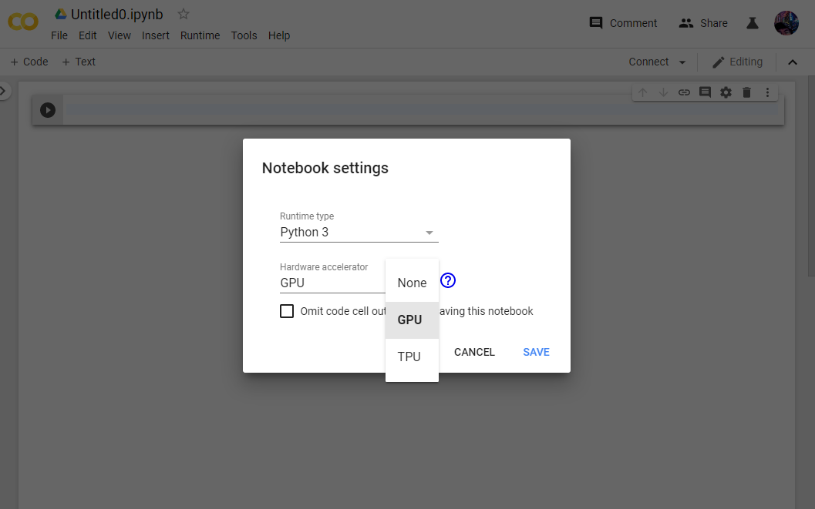
Getting Started
Go to https://colab.research.google.com
Create a new Python 3 notebook
From the ‘Runtime > Change runtime type’ menu, assign a hardware accelerator to your notebook

Slide 5
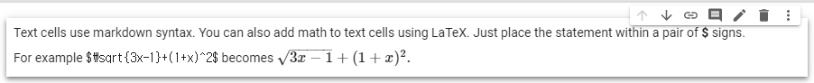
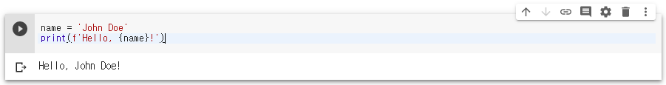
Notebook
Notebook is a list of cells which contain either explanatory text or executable code and its output
By clicking a cell, you can select the cell that you want to working with
Text cells help you explain your notebook and code cells you wrote
Code cells contain executable Python code and its output

Slide 6
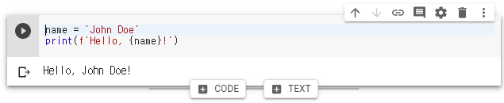
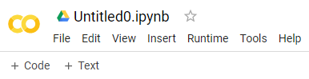
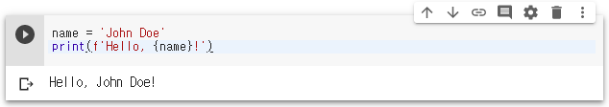
Working with Cells
You can add new code or text cells using the +CODE and +TEXT buttons
By selecting a cell, you can move up, move down or delete the cell
Buttons that appear when you hover between cells
Buttons in the notebook toolbar
Move Cell Up (Ctrl+M, K)
Delete Cell (Ctrl+M, D)
Move Cell Down (Ctrl+M, J)

Slide 7
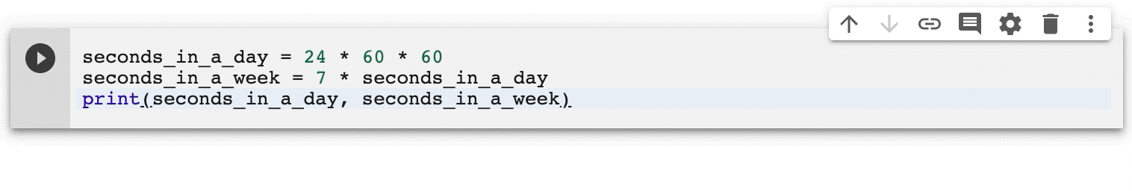
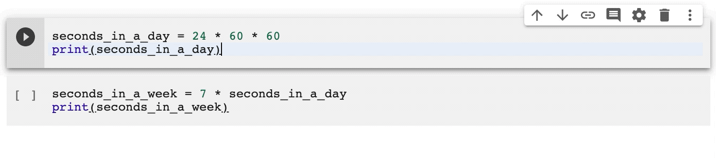
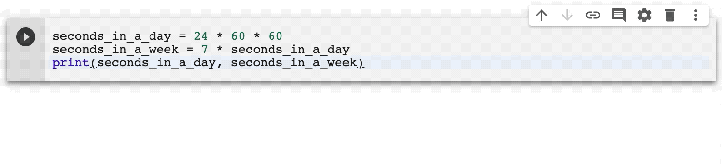
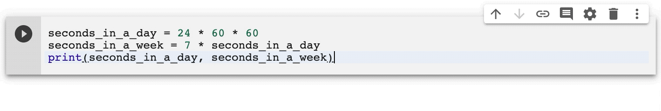
Working with Cells
You can execute a selected code cell in the following ways:
Click the Play button in the left of the cell
Type Ctrl+Enter to run the cell in place
Type Shift+Enter to run the cell and move focus to the next cell
Type Alt+Enter to run the cell and insert a new code cell immediately below it
Play button
Shift + Enter
Alt + Enter
Ctrl + Enter

Slide 8
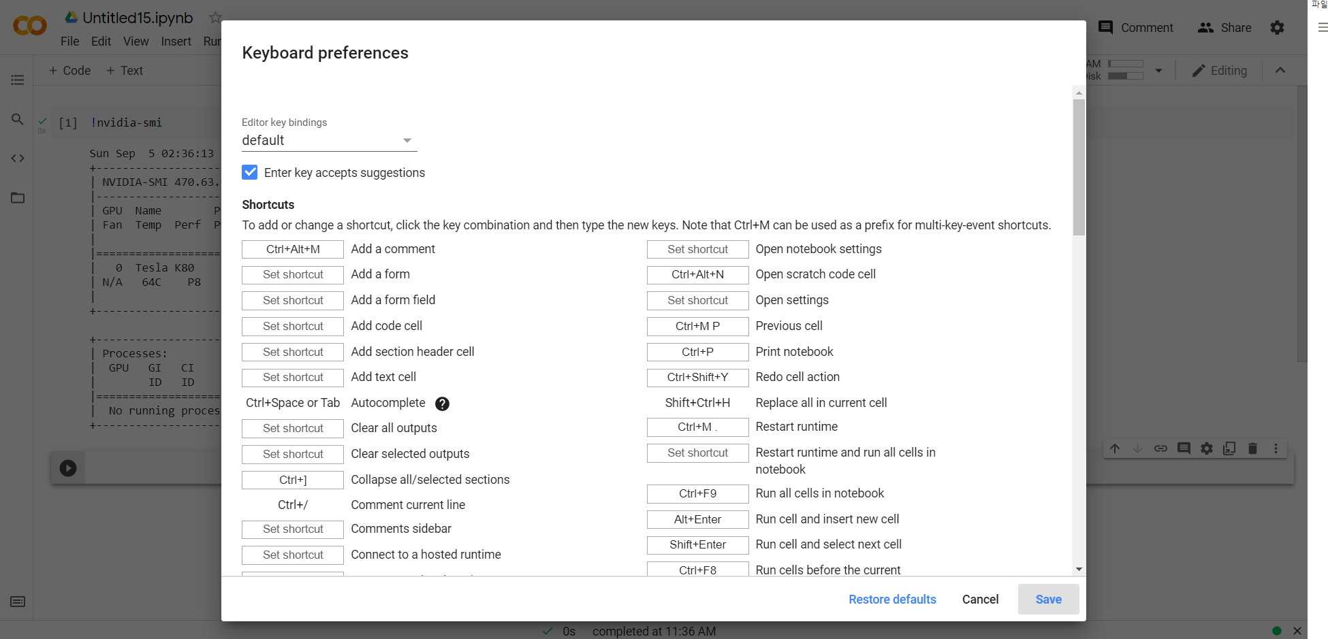
Working with Cells
You can check list of keyboard shortcuts by typing ctrl + m + h

Slide 9
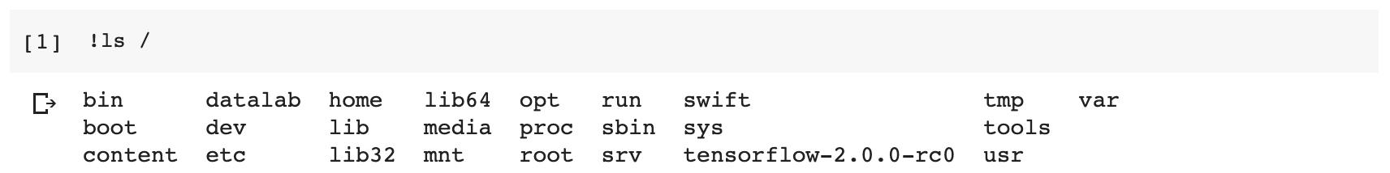
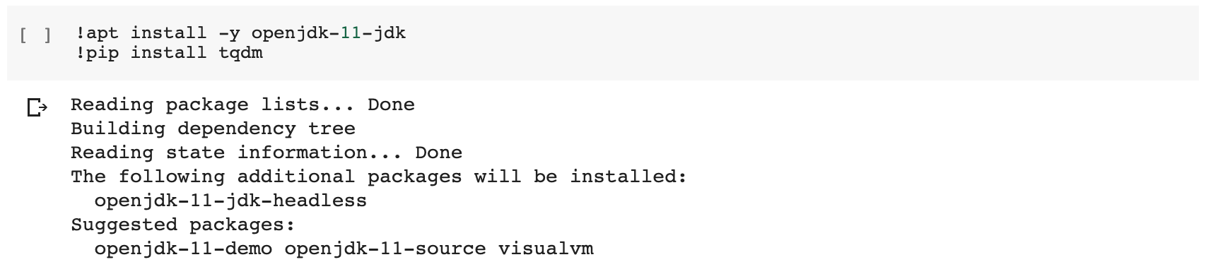
Working with Cells
You can run any command on the system shell by prefixing it with !
You can install third-party libraries using package managers as needed

Slide 10
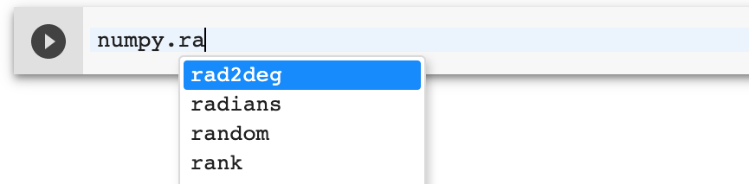
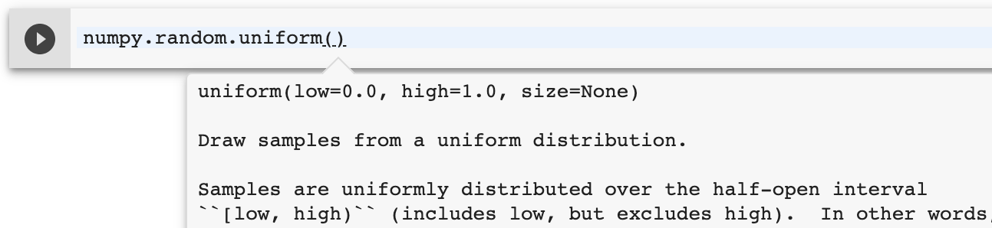
Working with Cells
You can use tab completion to explore attributes of Python objects, as well as to quickly view documentation strings
As an example, if you press Tab after numpy.ra, you will see the list of available completions starting with ra within the numpy module
You can see a pop-up of its documentation string

Slide 11
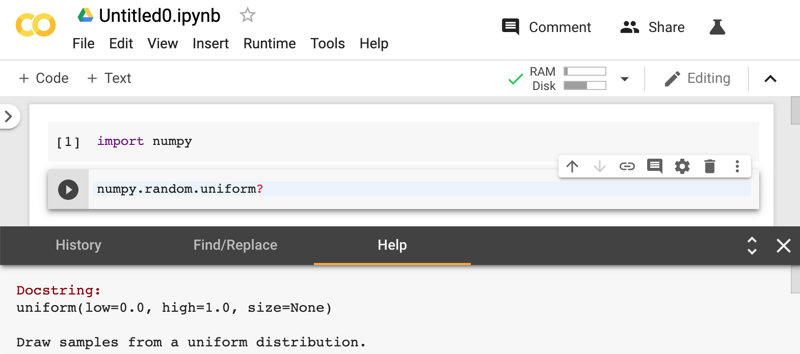
Working with Cells
To open the documentation in a persistent pane at the bottom of your screen, add a ? after the object or method name and run the cell

Slide 12
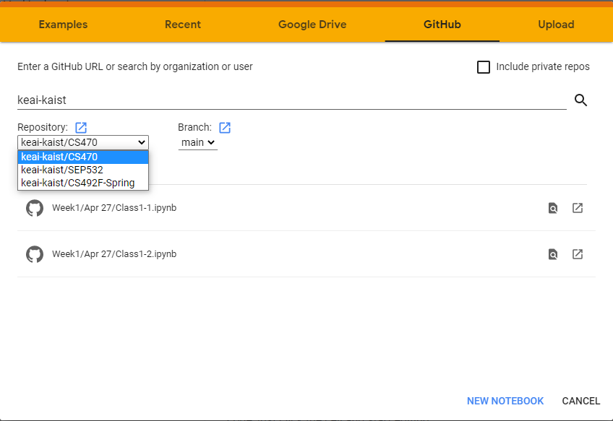
Fetching Notebooks from GitHub
You can fetch notebooks from GitHub repositories by searching them
In this lecture, we will upload all the notebooks to repositories by keai-kaist
1
2
3
4

